Slide 1

DATA ANALYTICS

Slide 2
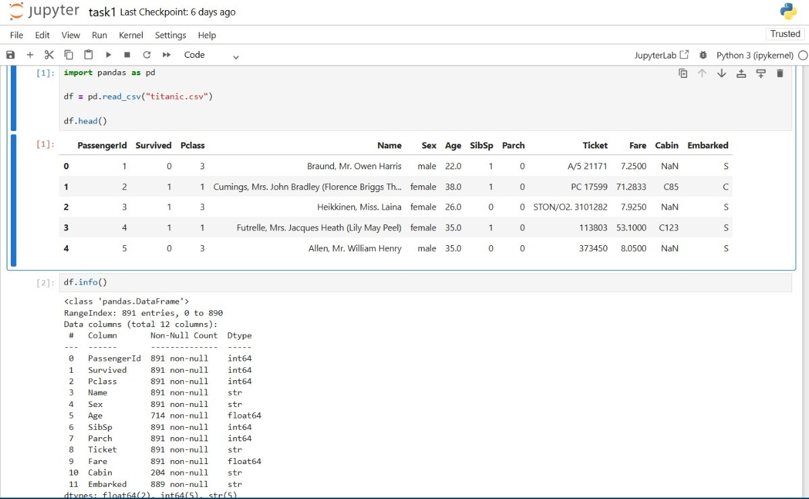
TASK 1
DATA IMMERSION & WRANGLING

Slide 3
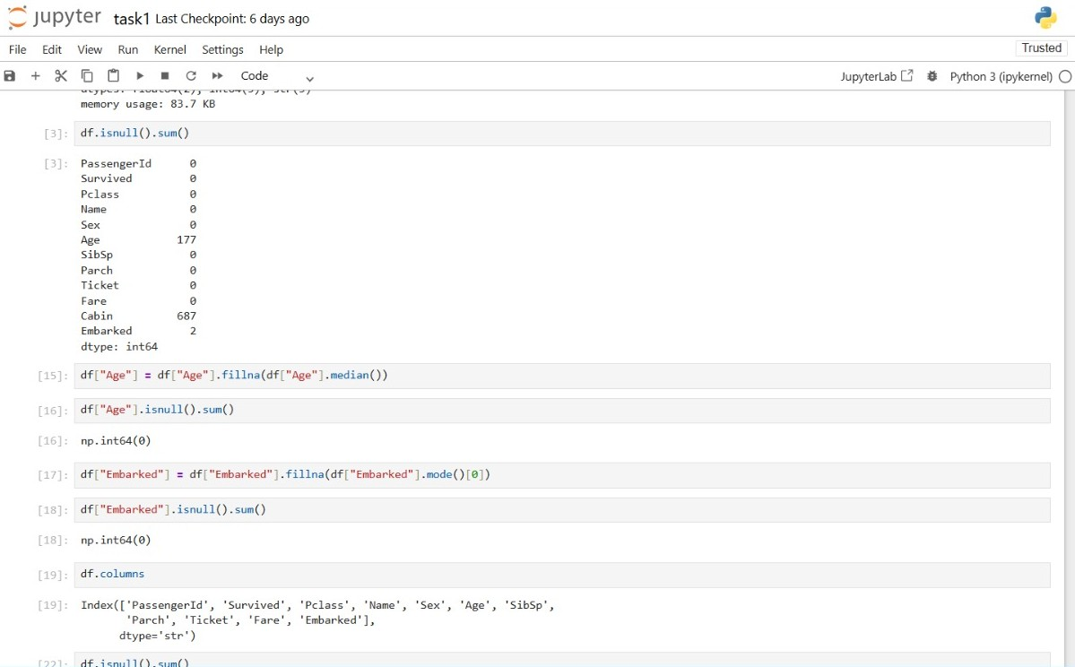

Slide 4
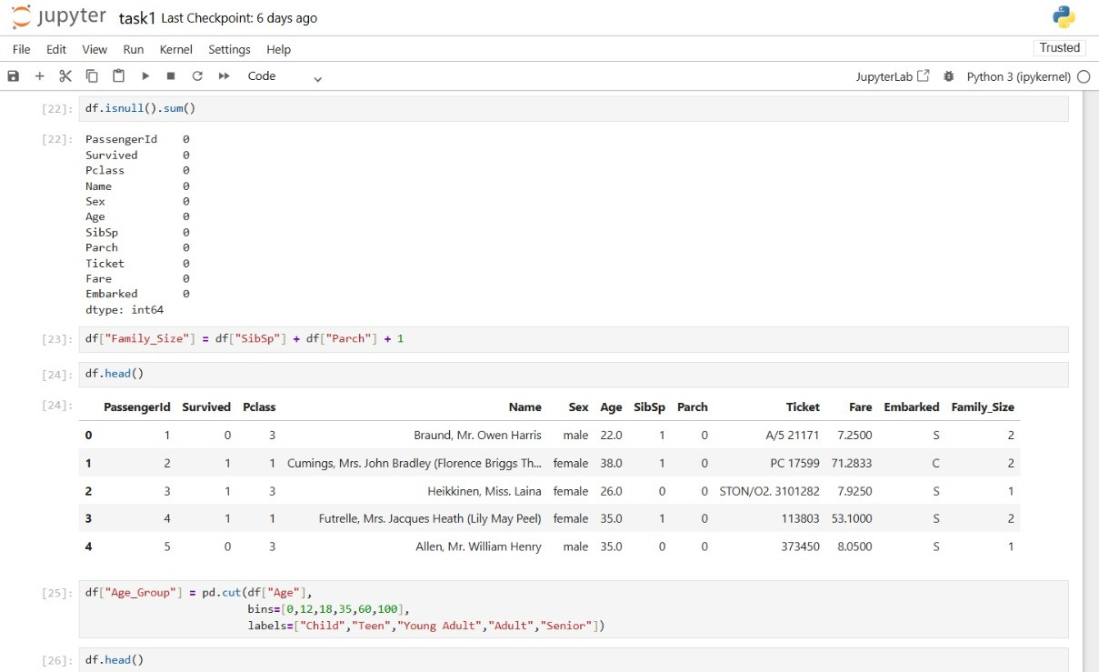

Slide 5
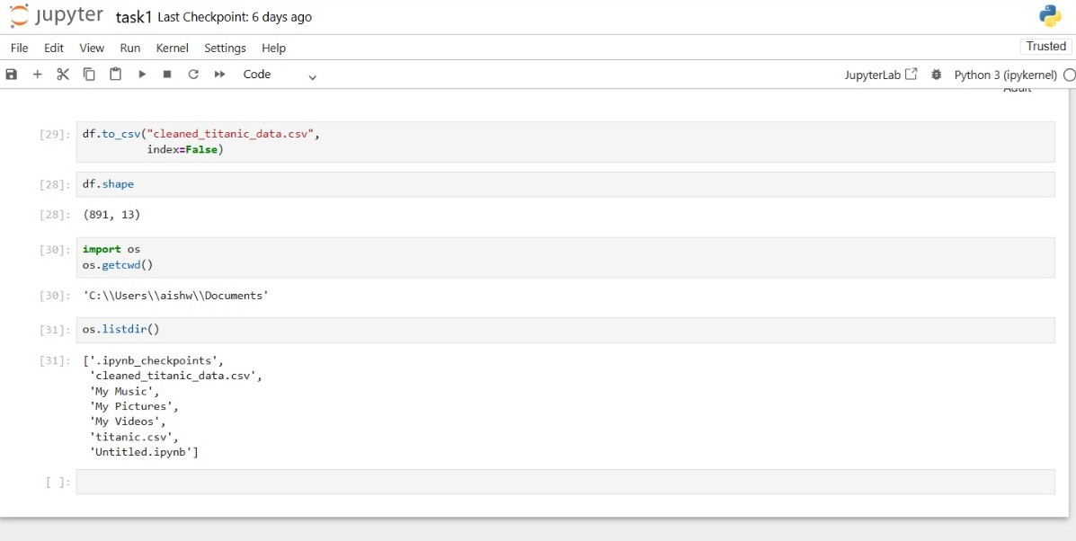

Slide 6
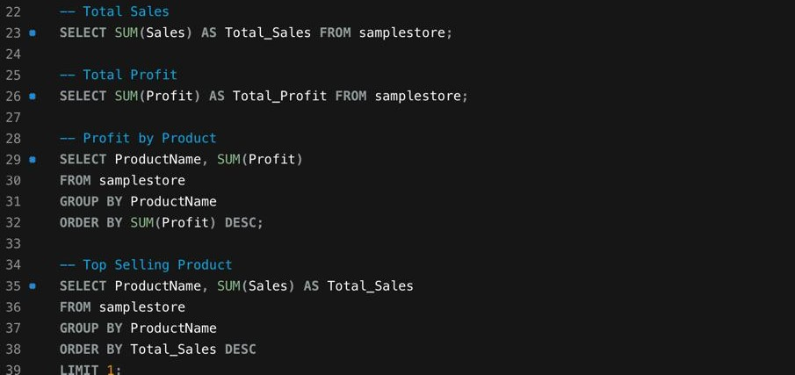
Task 2
EXPLORATORY DATA ANALYSIS (EDA) & BUSINESS INTELLIGENCE

Slide 7
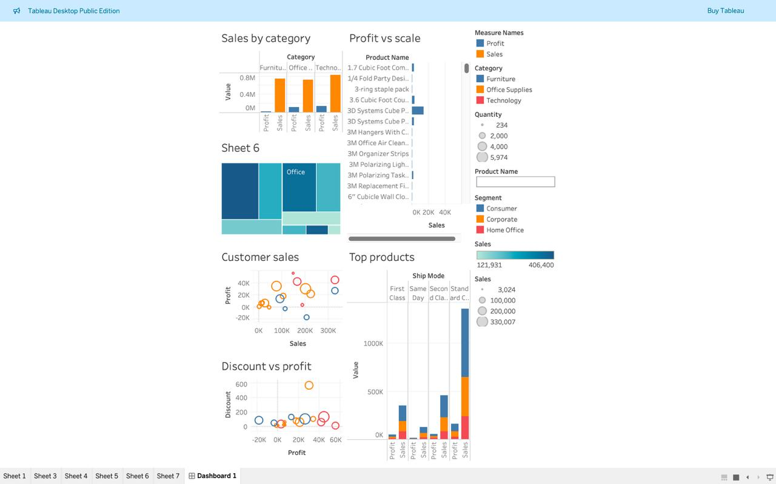
TASK 3
DEEP-DIVE ANALYSIS & INTERACTIVE DASHBOARDING

